Slide 1


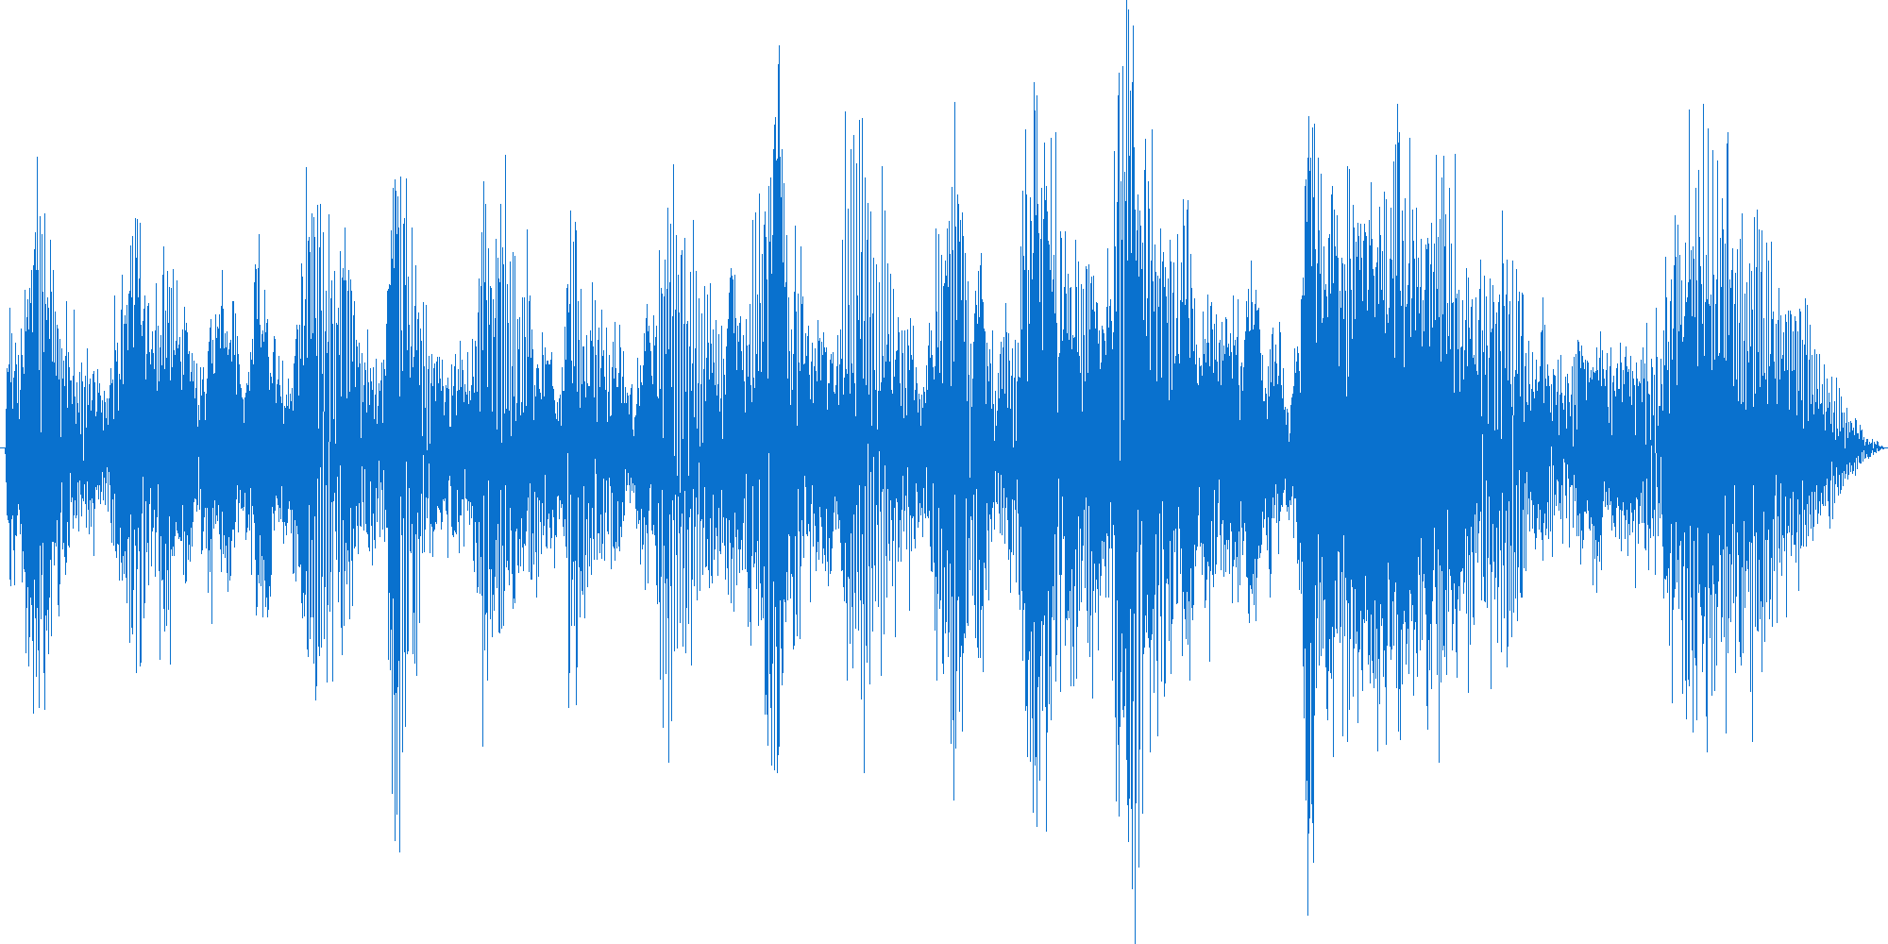


Phase 1: Pre-train
Generative
Contrastive
Predictive
representations
Upstream Model
Unlabeled Data
Phase 2: Downstream
“How are you?”
Speaker 42
Downstream Model 1
Downstream Model 2
SID
ASR
Upstream Model
Labelled
data
Labelled
data

Slide 2


Phase 1: Pre-train
Generative
Contrastive
Predictive
representations
Upstream Model
Unlabeled Data
Phase 2: Downstream
“How are you?”
Speaker 42
Downstream Model 1
Downstream Model 2
ASR
SID
Upstream Model
Labelled
data
Labelled
data

